Slide 1
Leveraging Generative AI to Modernize Applications
Scott Smith NCDEQ-NCDIT November 15, 2024

Slide 2
What is a model?
A mathematical representation of a real-world process.
When you supply some input to the model, the model can process it and relate it to some output.

Slide 3
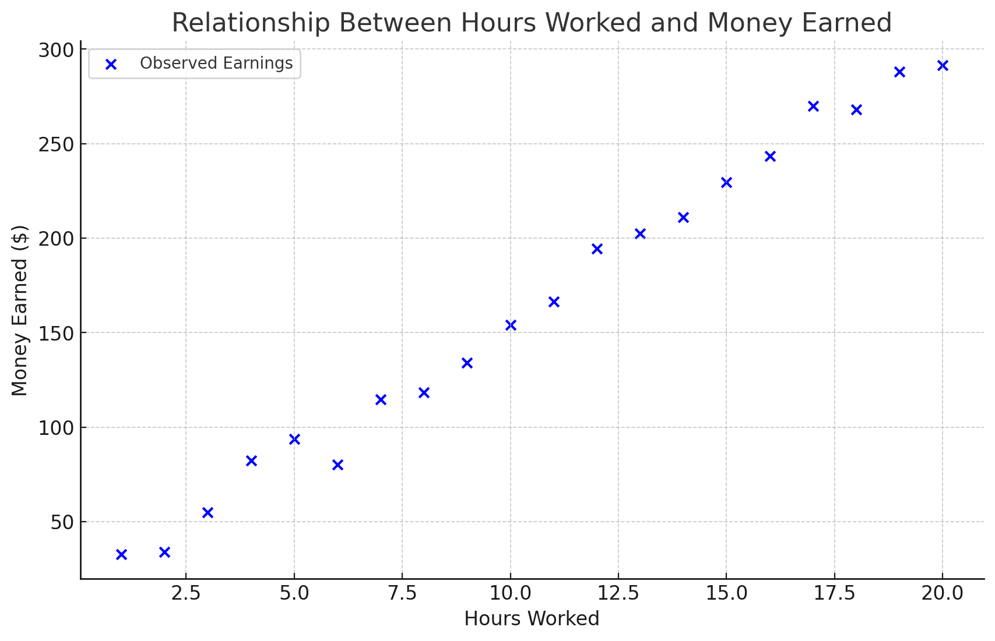
What is a Model?
Notes:
If we collect some data, in this case the number of hours we work, versus the money earned for those hours.
We can plot these data points on a graph.
But what if we want to know how much money we would earn if we worked 25 hours or 30 hours?

Slide 4
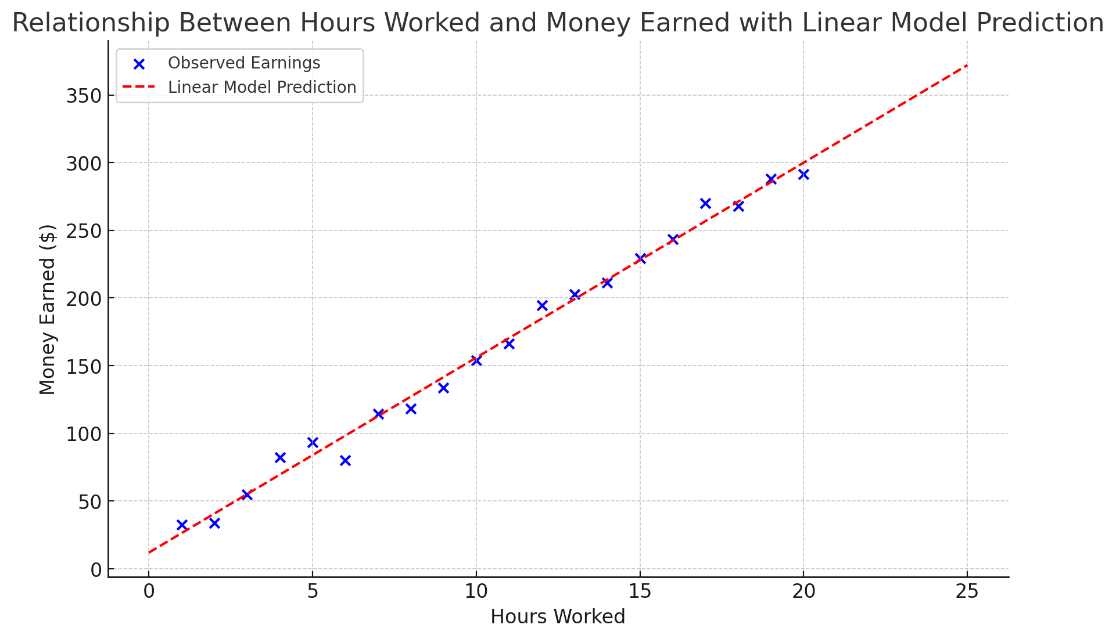
What is a Model?

Slide 5
Generative AI is just a model
(albeit a very complicated one!)

Slide 6
Use Case Number 1
Decoding the Past: Using Generative AI to Navigate Legacy Code

Slide 7
Use Case No. 1
Notes:
Ok, with that said, let’s move on to our first example:
At the Division of Marine Fisheries, we have data analysts who need access their database.
Normally a data analysts workflow may look something like this.

Slide 8
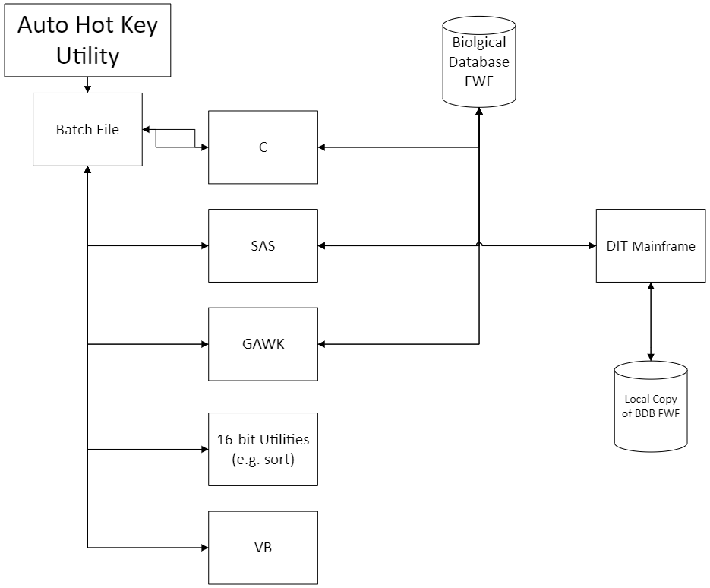
Use Case No. 1
Notes:
And here is the legacy DMF data analysis workflow…
As you can see, it is significantly more complicated.
About 2.5 years ago I was hired as part of a team to start modernizing this workflow.
[Explain the workflow]

Slide 9
Use Case No. 1
Notes:
Of all the old languages on this chart, there is one that sticks out – Gawk
Gawk is an implementation of the AWK language, and throughout this talk you may hear me use the two names interchangeably.

Slide 10
AWK is a powerful text-processing language commonly used in Unix/Linux environments to manipulate and analyze structured text data
Notes:
Awk is a text-processing language used for analyzing structured text data, usually in linux systems today.

Slide 11
I love AWK because it allows me to build the wrong solution to problems so quickly :)
-Dave on Stack Overflow
If we wanted to hire an AWK expert, we would need to recruit from a retirement home, not a university!
-Anonymous
Notes:
Just for fun, I’d like to share some interesting views I’ve heard about the language
As you can see, people have some strong opinions!
Now, with all this hate, some of you may be thinking, “Why don’t you just learn the language?” – And you may be right, but let me show you a snippet of code before I’m judged too harshly.

Slide 12
Use Case No. 1
BEGIN{k=1;i=1;nr=1;fc=1; hpset="\x1b(8U\x1b\x26\x6c\x31\x4f\x1b\x26\x6c\x31\x53\x1b\x26\x6c\x38\x44";
hp16="\x1b\x28\x73\x33\x34\x48\x1b\x26\x6c\x32\x43";#hp12="\x1b\x28\x73\x31\x37\x48\x1b\x26\x6c\x34\x43\x1b(s7B";}hp12="\x1b(6N\x1b(s0p16.67h8.5v0s0b0T\x1b\x26\x6c\x35\x43";
}{if(NR==1)fn=FILENAME;}{if(fc==1){if(fn==FILENAME){spc=substr($0,27,10);if(spc ~ /^[0-9]/){for(jj=length(substr($0,38));jj>0;jj--)if(substr($0,37+jj,1)==" ");else break;sp[spc]=substr($0,38,jj);}next;}else{fn=FILENAME;fc++;}}}{if(fn==FILENAME);else{if(i){i=0;pt(n,l,w,k,id,f);c[id]=k;print hpset "CONTENTS OF TRANSACTION FILE: " FILENAME " "AKA;}id=substr($0,2,1);
if(svid==id);else {svid=id;if(id ~ /[3459]/){print hp16 f[id];latin( );}else print hp16 f[id]"\n";}z="";for(y=1;y<c[id];y++)z=z substr($0,b[id,y],w[id,y]) "|";if(id ~ /[3459]/ && spc != substr($0,12,10)){latin( );}printf("%s%03d %s\n",hp12,nr++ % 1000,z);next}}
{if($1==id){ n[id,k]=$2;l[id,k]=length($2);b[id,k]=$3;w[id,k++]=$4;}else{if(NR==1);else {pt(n,l,w,k,id,f);c[id]=k;}
k=1;id=$1;n[id,k]=$2;l[id,k]=length($2);b[id,k]=$3;w[id,k++]=$4;f[id]="";}}function pt(n, l, w, k, id, f, j, p, q, r, s, t, e, u){\e=" ";
p=0;for(j=1;j<k;j++)if(l[id,j]>p)p=l[id,j];for(j=1;j<=p;j++){for(q=1;q<k;q++){t=2*w[id,q];r=int(t/2);t=t-r;u=" ";#if(j==p)u="|";else u=" ";if(l[id,q]<1+p-j)s=s substr(e,1,r+t+1)u;else s=s substr(e,1,r)substr(n[id,q],j-(p-l[id,q]),1)substr(e,1,t)u;}if(f[id]=="")f[id]=" " s;else f[id]=f[id] "\n " s;s="";}}function latin( ){spc=substr($0,12,10);print hp16 " " sp[spc]"\n\n";}
Notes:
This is an actual script that I inherited and had to support.
If this is legible by anybody at first glance I will be impressed!
I think my predecessor’s return key may have been malfunctioning…
[I know it’s minified, but a broken return key sounds way funnier]
Now some of you may be thinking that although its awful, you could likely work through this
But what if I told you that…

Slide 13
Use Case No. 1
6500 Lines
And this was just one script!

Slide 14
Disclaimer:
We use a version of ChatGPT that does not save any of our inputs and does not train on our data.
We can delete our data at any time.

Slide 15
Demonstration
Notes:
We were tasked with trying to understand this structure/data flow and to make edits to it
In 2021 we started experimenting with ChatGPT to solve some of these problems
And I would like to give you a quick demonstration of how it worked.
Prompt #1:
I have an AWK script that I would like some help understanding: BEGIN{k=1;i=1;nr=1;fc=1; hpset="\x1b(8U\x1b\x26\x6c\x31\x4f\x1b\x26\x6c\x31\x53\x1b\x26\x6c\x38\x44";
hp16="\x1b\x28\x73\x33\x34\x48\x1b\x26\x6c\x32\x43";#hp12="\x1b\x28\x73\x31\x37\x48\x1b\x26\x6c\x34\x43\x1b(s7B";}hp12="\x1b(6N\x1b(s0p16.67h8.5v0s0b0T\x1b\x26\x6c\x35\x43";
}{if(NR==1)fn=FILENAME;}{if(fc==1){if(fn==FILENAME){spc=substr($0,27,10);if(spc ~ /^[0-9]/){for(jj=length(substr($0,38));jj>0;jj--)if(substr($0,37+jj,1)==" ");else break;sp[spc]=substr($0,38,jj);}next;}else{fn=FILENAME;fc++;}}}{if(fn==FILENAME);else{if(i){i=0;pt(n,l,w,k,id,f);c[id]=k;print hpset "CONTENTS OF TRANSACTION FILE: " FILENAME " "AKA;}id=substr($0,2,1);
if(svid==id);else {svid=id;if(id ~ /[3459]/){print hp16 f[id];latin( );}else print hp16 f[id]"\n";}z="";for(y=1;y<c[id];y++)z=z substr($0,b[id,y],w[id,y]) "|";if(id ~ /[3459]/ && spc != substr($0,12,10)){latin( );}printf("%s%03d %s\n",hp12,nr++ % 1000,z);next}}
{if($1==id){ n[id,k]=$2;l[id,k]=length($2);b[id,k]=$3;w[id,k++]=$4;}else{if(NR==1);else {pt(n,l,w,k,id,f);c[id]=k;}
k=1;id=$1;n[id,k]=$2;l[id,k]=length($2);b[id,k]=$3;w[id,k++]=$4;f[id]="";}}function pt(n, l, w, k, id, f, j, p, q, r, s, t, e, u){\e=" ";
p=0;for(j=1;j<k;j++)if(l[id,j]>p)p=l[id,j];for(j=1;j<=p;j++){for(q=1;q<k;q++){t=2*w[id,q];r=int(t/2);t=t-r;u=" ";#if(j==p)u="|";else u=" ";if(l[id,q]<1+p-j)s=s substr(e,1,r+t+1)u;else s=s substr(e,1,r)substr(n[id,q],j-(p-l[id,q]),1)substr(e,1,t)u;}if(f[id]=="")f[id]=" " s;else f[id]=f[id] "\n " s;s="";}}function latin( ){spc=substr($0,12,10);print hp16 " " sp[spc]"\n\n";}
Prompt #2:
Can you please format that code so that it is more human readable?

Slide 16
Use Case Number 2
Bridging Expertise Gaps: Empowering Cross-Disciplinary Collaboration with Generative AI

Slide 17
NCDMF Ageing Program
The program harvests ageing structures from fishes throughout the year to determine fish ages for modelling
Otoliths are the most common structure

Slide 18
NCDMF Ageing Program
12,209 age samples collected in 2023
9,596 age samples were read
This is a manual process!

Slide 19
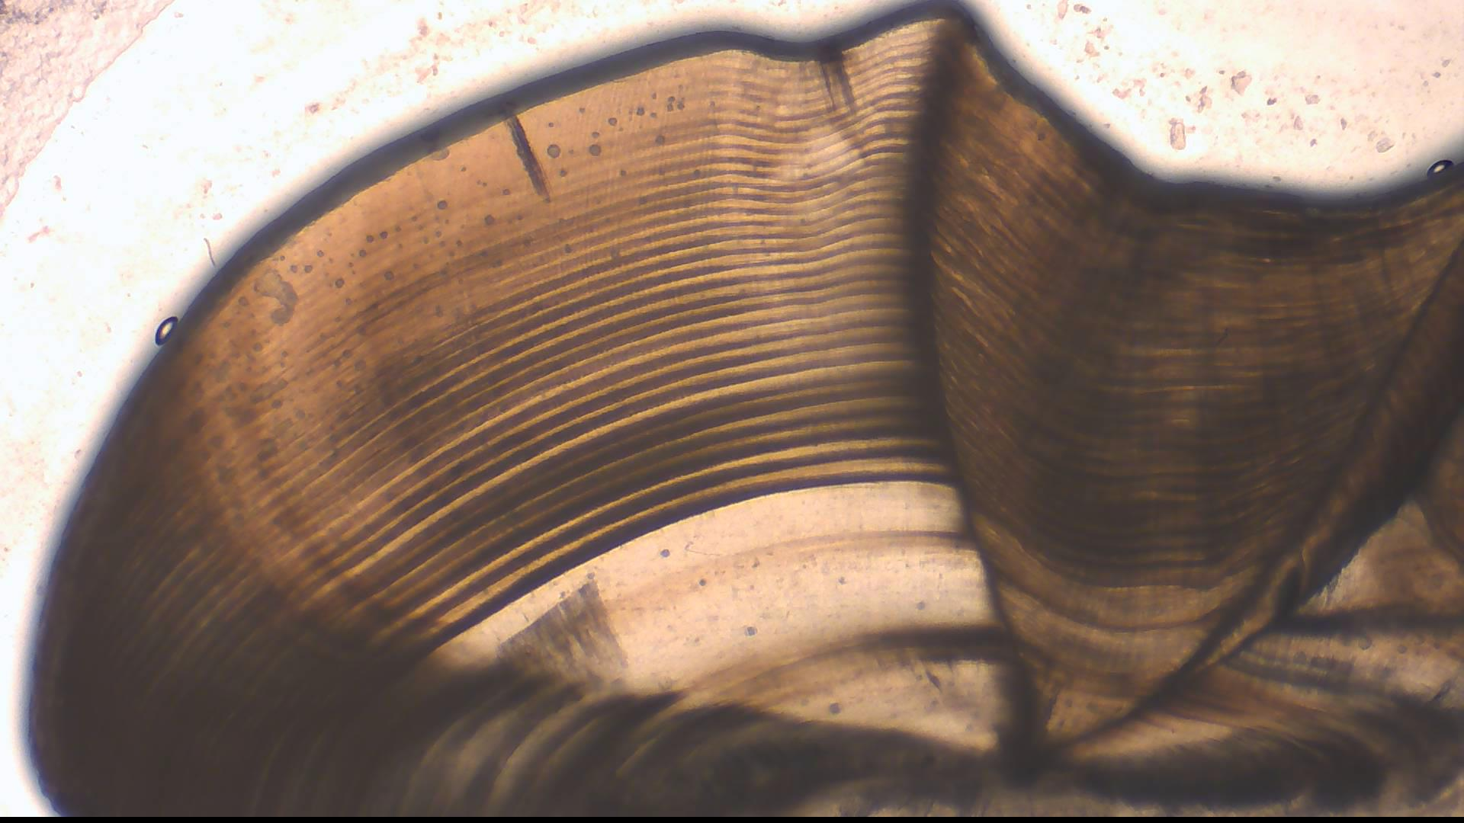

Slide 20
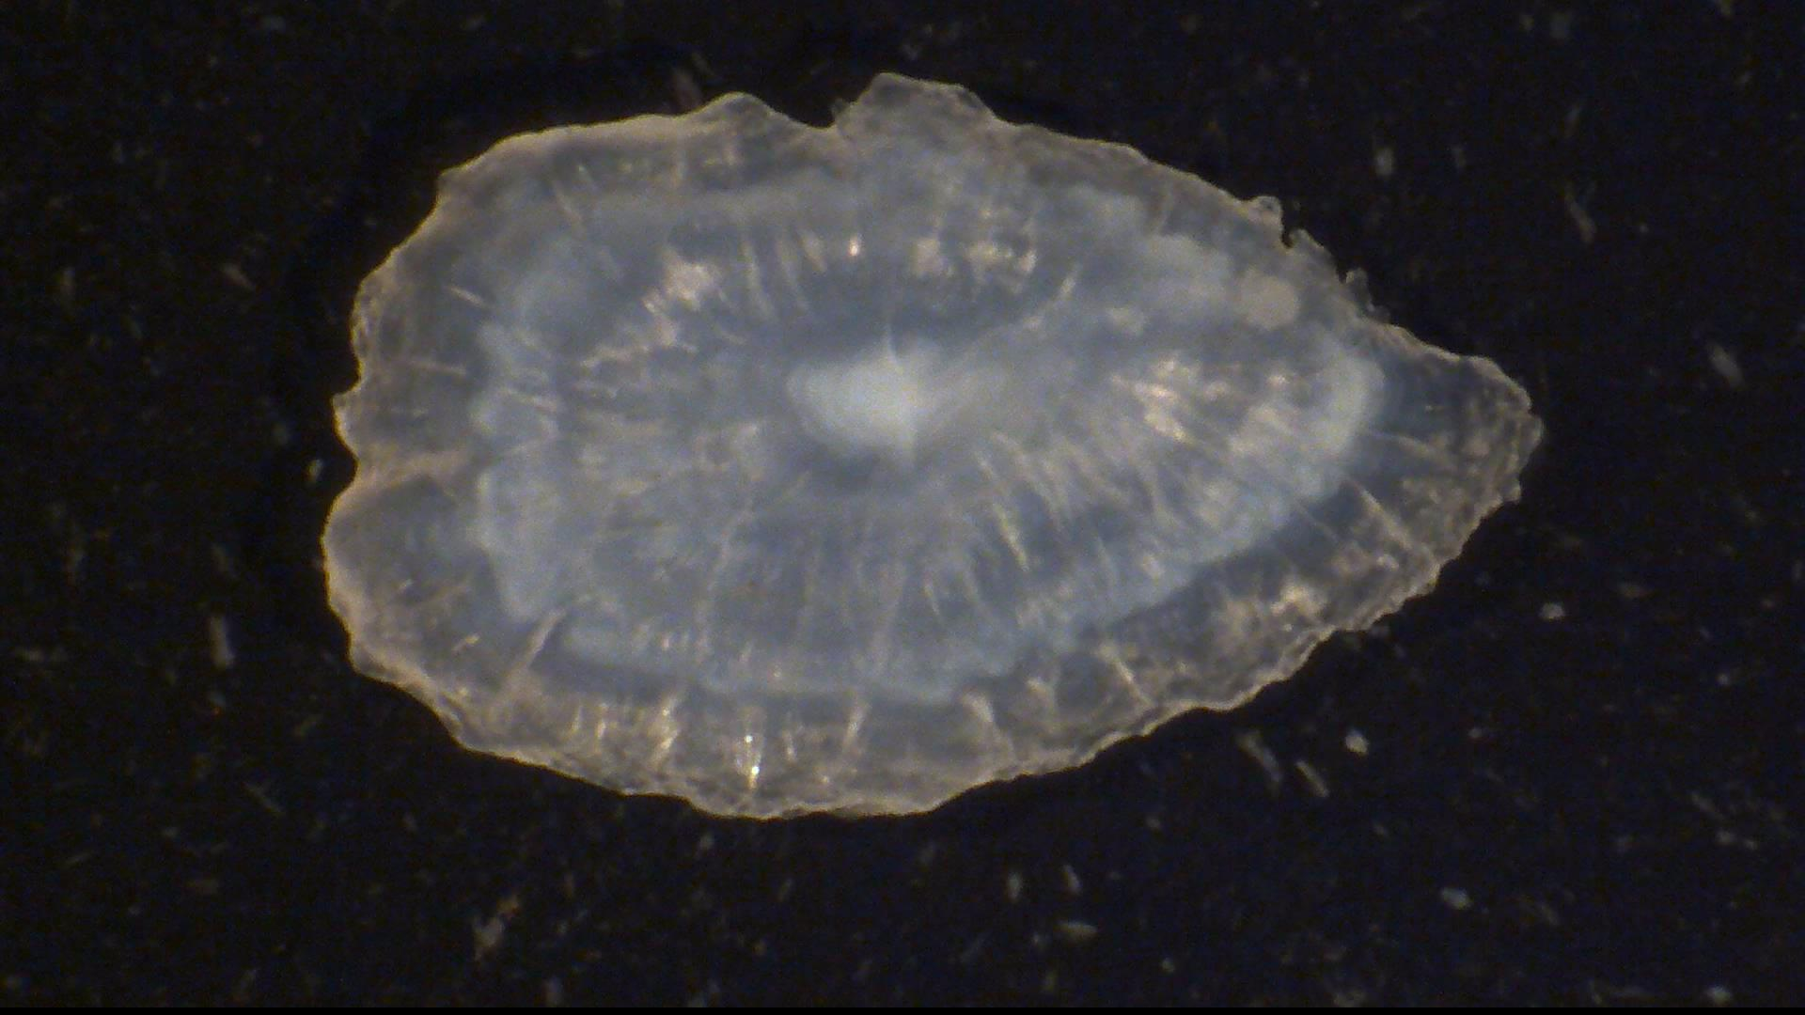

Slide 21
Can we leverage Machine Learning to help speed this up?

Slide 22
Humans:
Convolutional Neural Network:
~30 Seconds – 1 Minute per otolith
~0.01 Seconds per otolith
4,798 Minutes Total
x3 People
1.59 Minutes Total

Slide 23
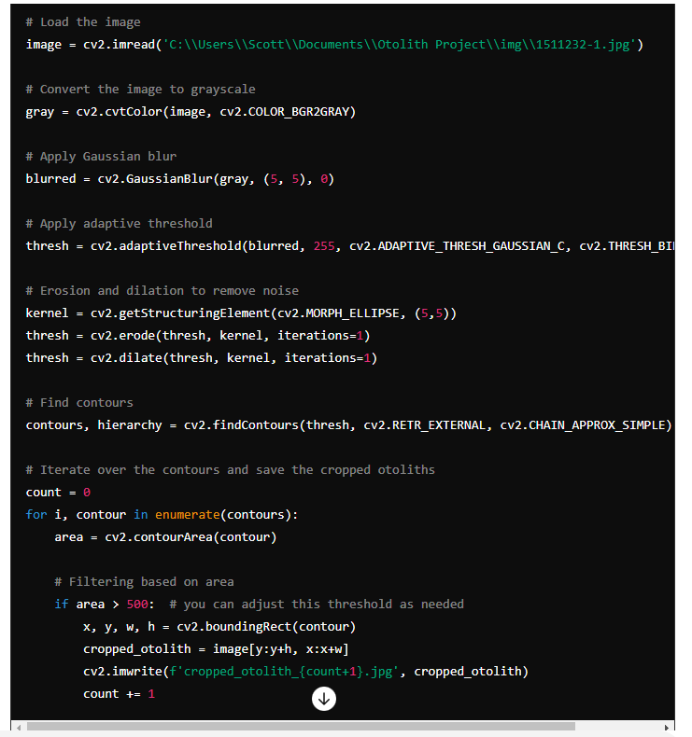
Use of GenAI
Walks you through code creation for a CNN
Helps you understand the stats, functions, and tests
Gives tailored guidance on errors, optimizations, etc.

Slide 24
Thank You
Mike Ware
Chief Information Officer
NCDEQ-DIT
mike.ware@nc.gov
Scott Smith
Biological Database Administrator
NCDEQ-DIT
scott.smith@deq.nc.gov
Semir Badic
Applications Systems Analyst
NCDEQ-DIT
semir.badic@deq.nc.gov

