Slide 1
Web Application Firewall Service (Cloudflare)
Travis Penny – Web Security Success Specialist Enterprise Applications – Digital Solutions November 15, 2024

Slide 2
Service Features
Web Application Firewall (WAF)
Application-Layer(7) DDoS protection.
Reverse proxy of public facing applications to obscure or eliminate exploitable attack vectors.
Advanced Bot Management – Crawlers and Scrapers
Turnstile – Captcha Replacement & Verification Tool
Aegis – Dedicated IPs for secure ingress/egress traffic.
SaaS user dashboard to manage applications and security posture at a granular level.

Slide 3
Service Features Continued
Managed/Authoritative DNS – Primary and Secondary DNS
Dedicated Technical Account Manager (TAM) Support
24/7 Emergency enterprise support – Call/Chat
Renewal agreement secured to provide “Whole-of-State” service model to NC.
State agencies, city and local gov, higher education and community colleges may utilize WAF service through NCDIT

Slide 4
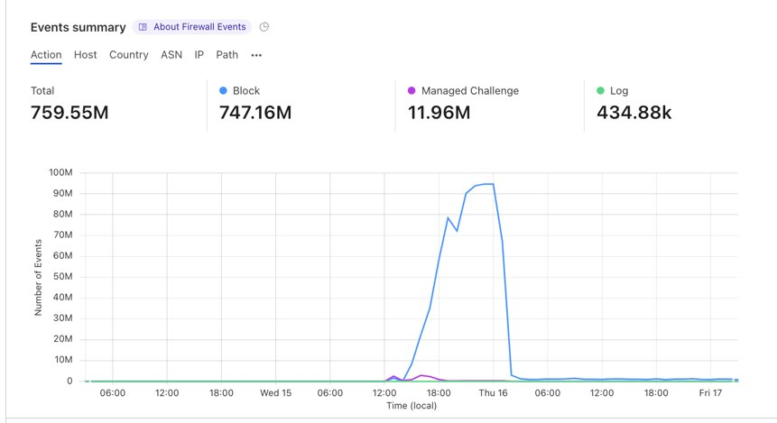
Case Study: DDoS Attack on NCCU.edu

Slide 5
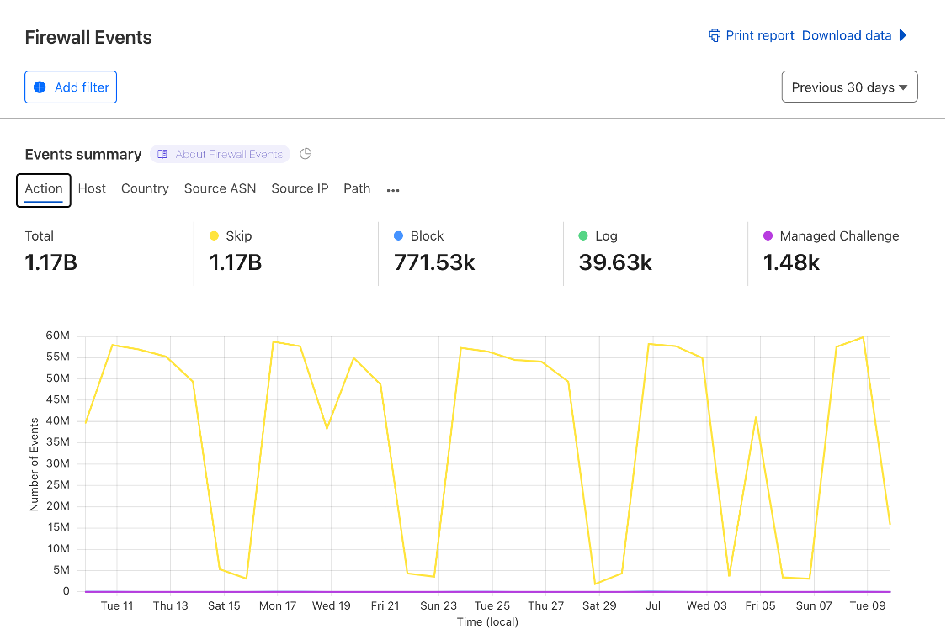
Case Study: Threat Mitigation on ncdhhs.gov

Slide 6
Case Study: Disaster Recovery - Defacement

Slide 7
Where NC stands with WAF service deployment
NC Wildlife (DNCR) – Onboarded to Cloudflare, protecting apps .
NC Ports – Onboarded to Cloudflare, protecting and testing.
Higher Education & Community Colleges – Onboarded, protecting applications. Utilizing DNS and enterprise features.
City and Local Gov Agencies – Strong interest in utilization of enterprise features offered through NCDIT-Cloudflare service agreement.
Over 100 root domains being protected within Cloudflare, with 425 DNS records under those root domains spread across 22 agency accounts.

Slide 8
Value Proposition of WAF service
Cloudflare Dashboard: real-time threat analysis and assessment of WAF solutions
Managed WAF Rulesets: Robust "living" threat protection, enabled in seconds. OWASP Top 10
Custom Rulesets: Extreme granularity in threat response:
Rate limiting
Geo-blocking
Exceptions for special cases, IP CIDR range allowlists/denylists
Managed/Authoritative DNS – Easy migration and management of DNS to host and protect applications.
Advanced Bot Management & Turnstile – Block or manage unwanted bots, scraping and crawling.
What once took 2-4 teams across multiple agencies, emails, and headaches to block a threat, may now take 1 trained application owner to deploy in seconds, within Cloudflare.

Slide 9
Closing Slide
Travis F Penny
Web Security Success Specialist
travis.penny@nc.gov

