Slide 1
AI-Driven Chatbots
Demonstrate the benefits, functionality, and value of implementing chatbot to improve content accessibility and service

Slide 2
The Value of NCDIT AI Chatbot Service
Improved Accessibility
Enhanced User Experience
Time and Resource Efficiency
Scalability Across Agencies
Notes:
Improved Accessibility: Chatbots allow users to quickly find the information they need without navigating complex menus or waiting for human support.
• Enhanced User Experience: Immediate responses to inquiries improve user satisfaction, especially for common questions.
• Time and Resource Efficiency: Chatbots reduce the burden on state agency staff by handling frequent, repetitive questions.
• Scalability Across Agencies: This service can be implemented across various agencies, each with a customized knowledge base built from their website’s content.

Slide 3
How it Works: Tailoring Content for Each Agency
Website Crawling and Indexing
Targeted Answers
Dynamic Updates
Notes:
• Website Crawling and Indexing: Each agency’s website will be crawled, and the content indexed to create a knowledge base specific to that agency.
• Targeted Answers: The chatbot draws on this agency-specific information to respond accurately to user questions.
• Dynamic Updates: As the agency’s site content changes, the chatbot’s knowledge base is updated, ensuring the responses remain current.

Slide 4
Key Technologies: RAG, OpenAI, and Zammo
Retrieval-Augmented Generation (RAG)
OpenAI's Language Model
Zammo Integration
Notes:
• Retrieval-Augmented Generation (RAG):
• Role: Retrieves relevant information from the indexed content to supplement chatbot responses.
• Benefit: Increases accuracy by ensuring answers are directly linked to official website content.
• OpenAI’s Language Model:
• Role: Powers natural language understanding and response generation, creating conversational responses based on the retrieved data.
• Benefit: Provides users with clear, human-like responses, making interactions feel more intuitive.
• Zammo Integration:
• Role: Facilitates seamless deployment and integration of the chatbot on each agency’s website.
• Benefit: Simplifies setup and maintenance, allowing easy adaptation across different agency sites.

Slide 5
Prompt Created
Generates conversational answer based on retrieved content
User Question (Input)
Language Model (Azure OpenAI)
Content Retrieval (Search)
Retrieves relevant content based on keywords
Response Validated
Model Response is compared to retrieved content to ensure it’s grounded.
Question and relevant content used to create AI Prompt
Response Displayed
Chatbot displays the answer
Notes:
User Question: This is where it starts. User types a question or prompt like How do I get a REAL ID?
Content Retrieval: The query/question goes through a retrieval layer that performas a keyword search on the indexed content. (Web pages, documents (pdfs, word documents, etc) from the agencies website. It finds the relevant docuemtns or snippets that may contain the answer.
Relevant Content: The retrieval later surfaces the relevant content and is passed to the next stage.
Language model: The retrieved content is sent to the language model (OpenAI in our case) to generate a concise, natural language response. The model interprets the question and craft an answer based on the retrieved content.
Response displayed: The generated answer is then displayed to the user in the chatbot interface, providing a conversational response based on the agency's indexed information.

Slide 6
Using a Wrapper to Manage Responses
Zammo.ai
Chat Input Question Received
Response Provided
“My Focus Is IT Procurement”
“I don’t know…”
Wrapper Function
No
Yes
Valid?
Relevant Info Found?
No
Response Valid?
No
Yes
Yes
Azure OpenAI
Content Retrieval
Generate Response
Notes:
Wrapper function acts as gateway between Zammo and Open AI
Here’s a high-level view of the approach that we use to accomplish this.
Uses Azure function micro services
Ensures that the question is legitimate and then whether it has enough information to attempt a response.
Once response is generated its evaluated to ensure that it appears valid before it is provided to the customer.

Slide 7
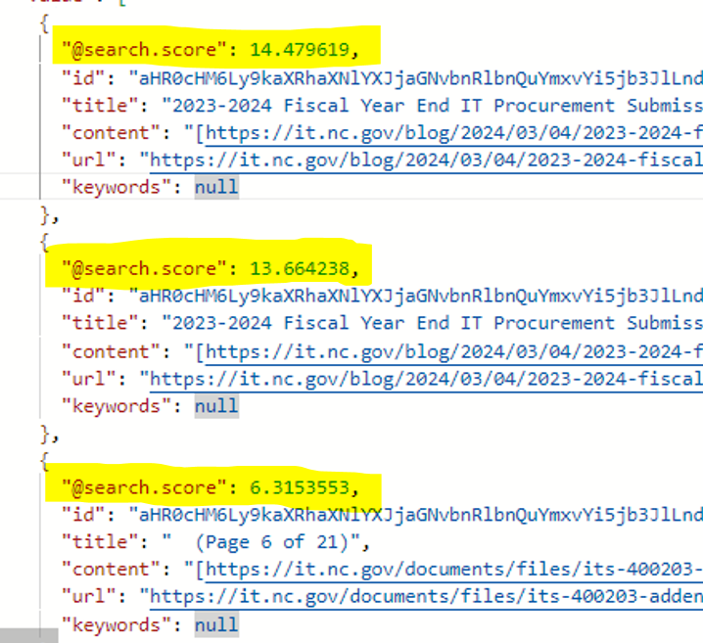
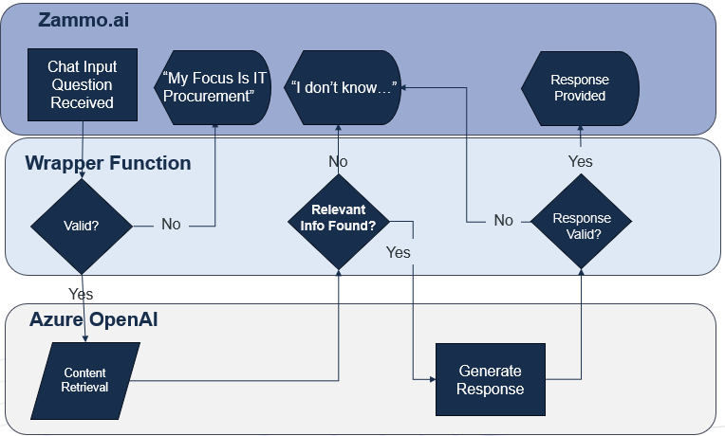
Relevant Info? : Preventing Hallucination
Notes:
Insufficient information causes hallucinations
Embedding searches return a score of how closely the retrieved data matches the question
Early on, we established a scoring threshold to help predict if the sufficient information is available
If the highest score of the information does not meet/exceed the threshold, the chatbot responds that it doesn’t know.

Slide 8
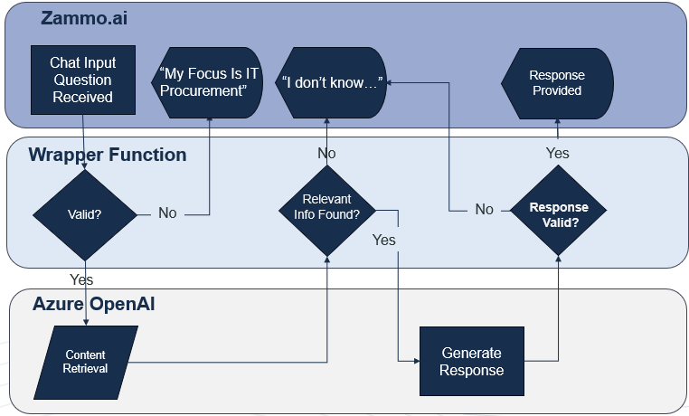
Response Valid? : Ensuring Grounding
Notes:
Since we ask the model for links to source information it used to create the answer, we use links to validate responses
If response contains a link that doesn’t align with the retrieved content that was provided, the answer is rejected
When this occurs, a second attempt is made to get a proper response
If that fails validity check too, chatbot responds that it was unable to answer the question.

Slide 9
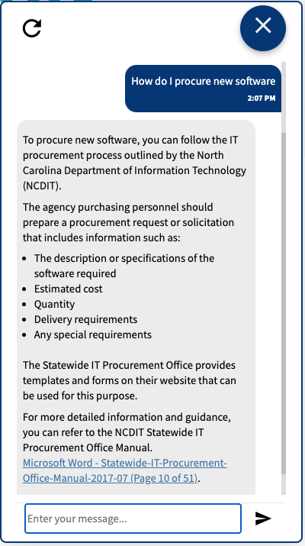
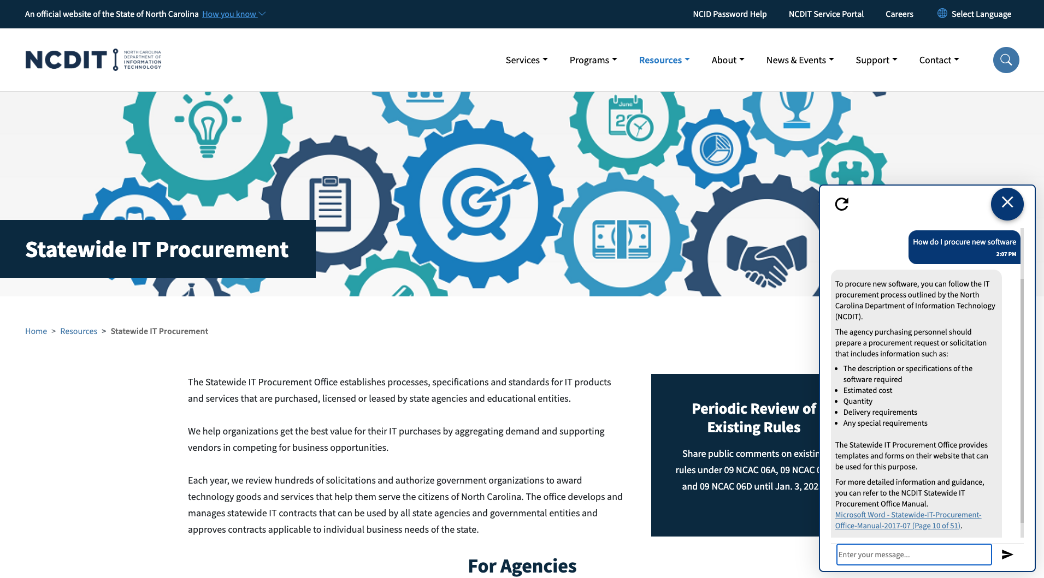
Chatbot Example

Slide 10
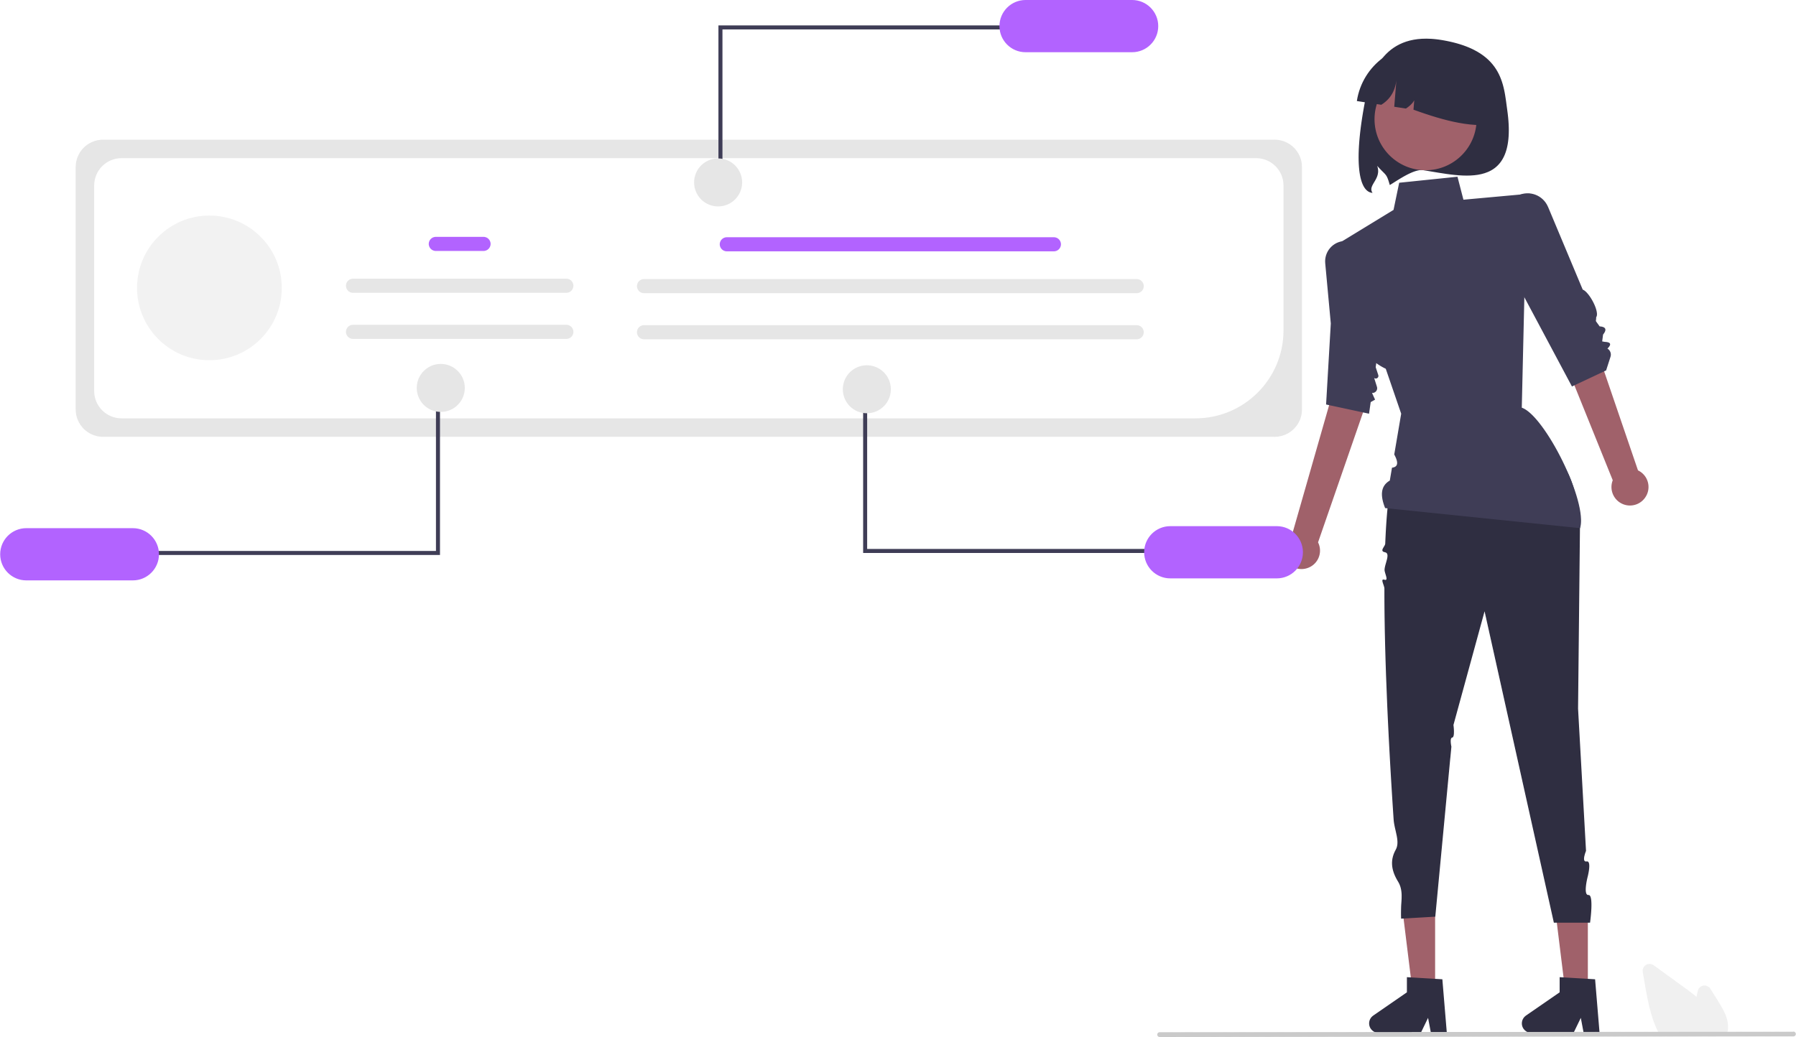
Privacy and Compliance Considerations
Data Handling and Compliance
Transparency
Adaptation to State Privacy Regulations
Notes:
Data Handling and Compliance: Only publicly available information is used, ensuring that user privacy and data security are maintained.
Transparency: Users will be informed that the chatbot responses are based solely on content from the agency’s public site.
Adaptation to State Privacy Regulations: Chatbot deployment and data handling processes are aligned with state-specific privacy and data protection requirements.

Slide 11
Benefits Recap and Summary
Key Benefits
Improved accessibility and user satisfaction
Streamlined access to information for the public
Reduced workload for agency staff
Notes:
• Website Crawling and Indexing: Each agency’s website will be crawled, and the content indexed to create a knowledge base specific to that agency.
• Targeted Answers: The chatbot draws on this agency-specific information to respond accurately to user questions.
• Dynamic Updates: As the agency’s site content changes, the chatbot’s knowledge base is updated, ensuring the responses remain current.

Slide 12
Closing Slide
John Lewton
Platform Engineer
john.lewton@nc.gov

