Slide 1
Framing the Journey: One State Agency’s Plan for Improving Accessibility
Donna Murray, Digital Accessibility Specialist
NC Department of Public Instruction

Slide 2
ACCESSIBILITY
FOR ALL
COMPLIANCE + CULTURE

Slide 3
DEFINING THE WORK
SCOPE
DPI
PSUs
Educators
STAKEHOLDERS
Students
Families
Communities
Employees

Slide 4
DEVELOPING THE STRATEGY
GOALS
Achieve compliance
Build capacity
Implement processes
Manage risks
Foster culture of accessibility

Slide 5
DEVELOPING THE STRATEGY
Awareness & communication
Audit & remediation
Resources & support
Design & procurement
Roles & responsibilities

Slide 6
AWARENESS &
FOUNDATIONAL KNOWLEDGE

Slide 7
COMMUNICATION
Key groups (e.g., procurement, communications)
Office/department-specific
Alignment to goals

Slide 8
SELF-ASSESSMENT

Slide 9
IDENTIFYING THE
CURRENT LANDSCAPE
INVENTORY
Created
Procured
Shared
AUDIT
Accessibility
Processes
Resources

Slide 10
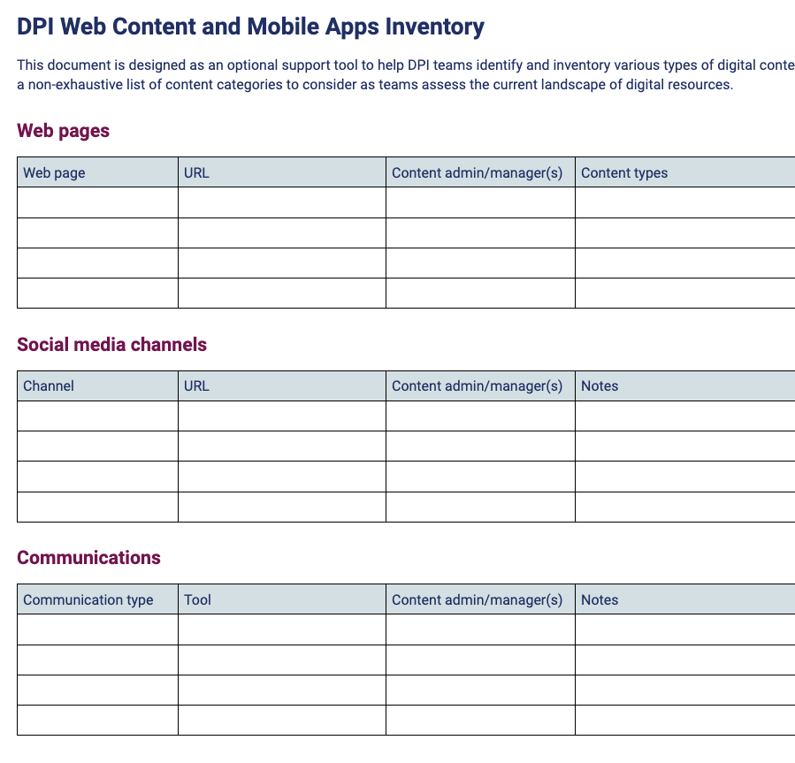
AUDIT & REMEDIATION

Slide 11
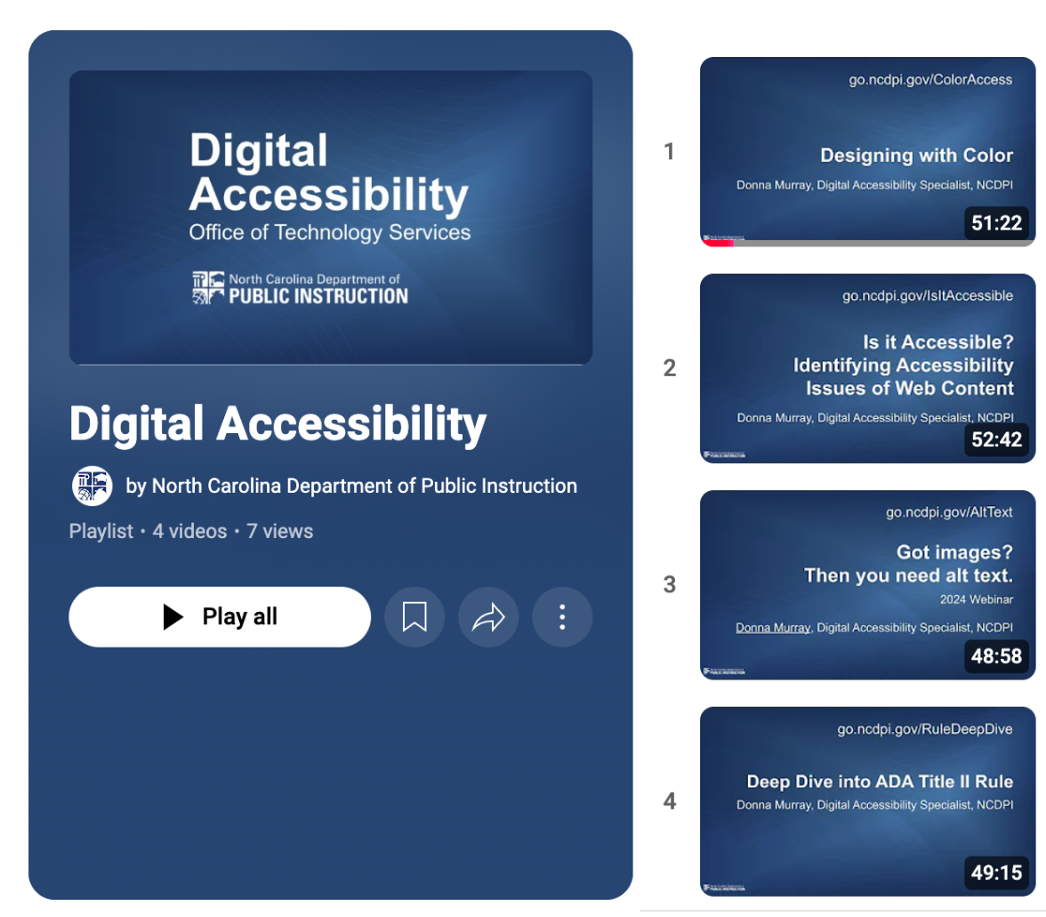
RESOURCES & SUPPORTS
Professional learning
Technical assistance
Consultative support

Slide 12
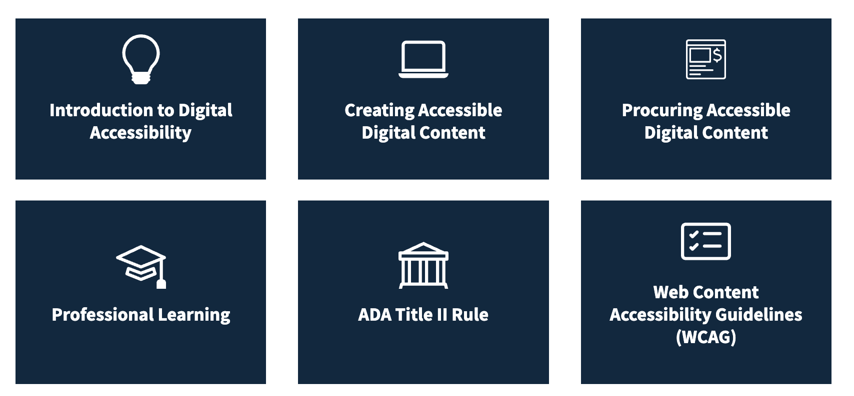
DIGITAL ACCESSIBILITY SITE

Slide 13
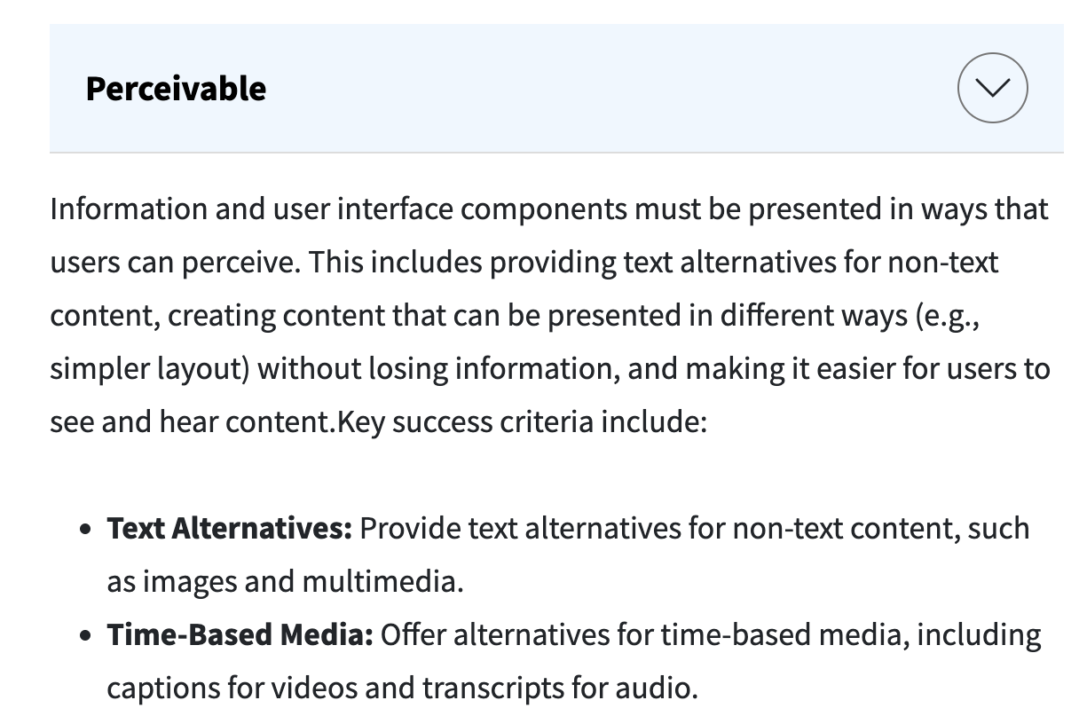
DESIGNING CONTENT
Information governance
Accessible templates
Design processes

Slide 14
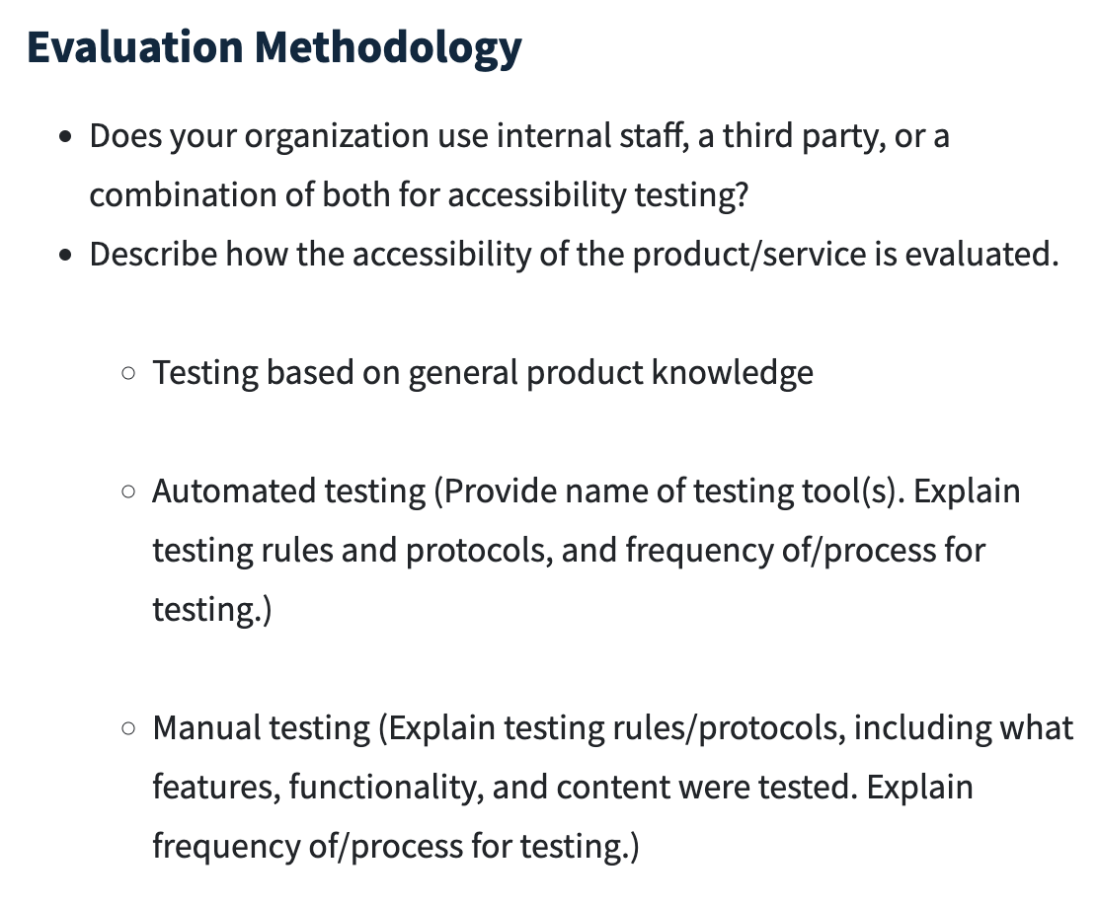
PROCURING CONTENT
Project life cycle
Collaborating with suppliers
Processes

Slide 15
RISK MANAGEMENT

Slide 16
ROLES & RESPONSIBILITIES
Everyone’s job and someone’s job
Shared responsibility
Leverage learning together

Slide 17
STRATEGIC PARTNERSHIPS
NCDPI Offices
Communications
Exceptional Children
IT Project Management
Communities of practice
Agencies in other states

Slide 18
LESSONS ON THE JOURNEY
Automated testing is not enough
User engagement is key
This will be an iterative process
Focus on progress over perfection
Accessibility isn’t an add-on

Slide 19
ACCESSIBILITY
FOR ALL
CULTURE > COMPLIANCE

Slide 20
RESOURCES DOCUMENT
go.ncdpi.gov/
FramingTheJourney

